Slide 1
ELI-DL examples
Version : « v2 »
Last updated : 01-10-2022
Editor : thomas.francart@sparna.fr

Slide 2
Events / Activities
Works / « Documents »
property / link
Concepts / Controlled values
Out of scope
of ELI Draft Legislation extension
Subclass of

Slide 3
Example : a Bill in Ireland

Slide 4
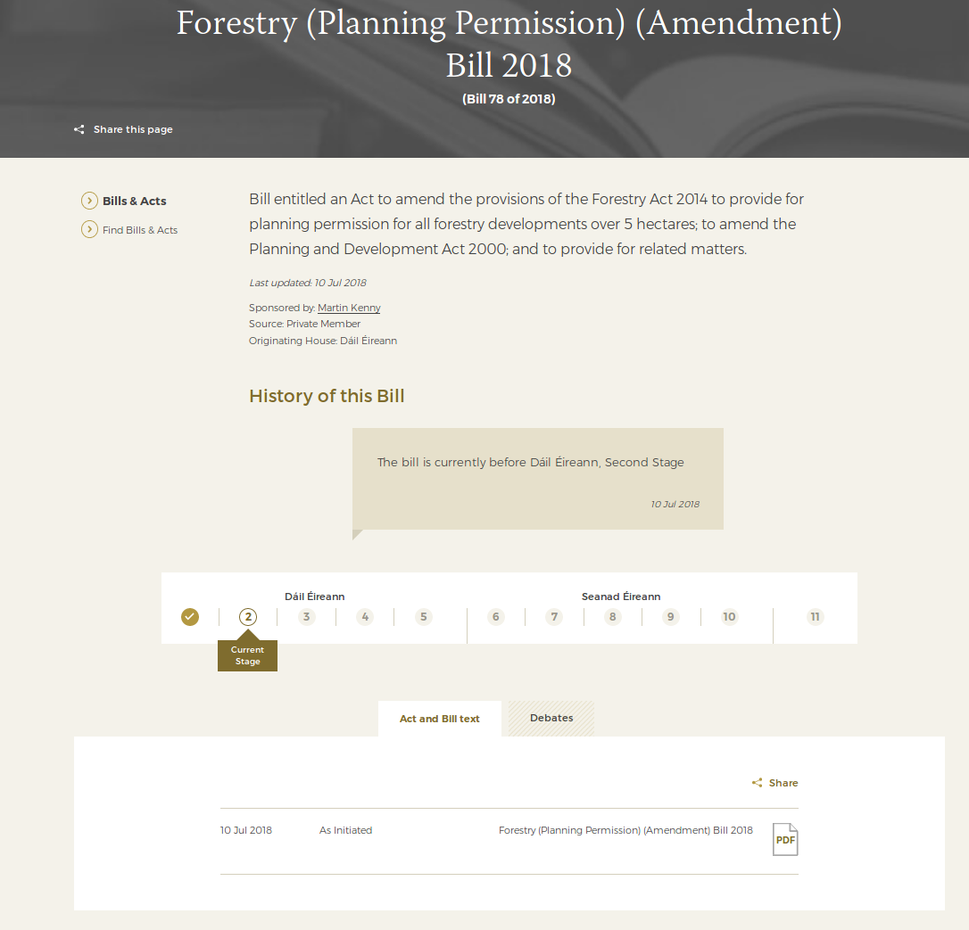
https://www.oireachtas.ie/en/bills/bill/2018/78/?tab=debates

Slide 5
ProcessType : Bill
process_type
LegislativeProcess
process_title : Forestry (Planning Permission) (Amendment) Bill 2018
process_number : « 78 »
process_description: « Bill entitled an Act to amend… »
date_last_update : 2018-07-10
Person : Martin Kenny
ProcessStatus : Ongoing
had_responsible_person
process_status

Slide 6
ProcessType : Bill
process_type
LegislativeProcess
process_title : Forestry (Planning Permission) (Amendment) Bill 2018
process_number : « 78 »
process_description: « Bill entitled an Act to amend… »
date_last_update : 2018-07-10
Person : Martin Kenny
ProcessStatus : Ongoing
had_responsible_person
process_status
consists_of
latest_activity
current_stage
ProcessStage : « Dàil first stage »
consists_of
ProcessStage : « Dàil second stage »
LegislativeActivity
activity_label : « Dàil first stage »
activity_start_date : 2018-07-10
activity_end_date : 2018-07-10
LegislativeActivity
activity_label : « Dàil second stage »
activity_start_date : 2018-07-10
occured_at_stage
occured_at_stage

Slide 7
ProcessType : Bill
process_type
LegislativeProcess
process_title : Forestry (Planning Permission) (Amendment) Bill 2018
process_number : « 78 »
process_description: « Bill entitled an Act to amend… »
date_last_update : 2018-07-10
Person : Martin Kenny
ProcessStatus : Ongoing
had_responsible_person
process_status
consists_of
latest_activity
current_stage
ProcessStage : « Dàil first stage »
consists_of
ProcessStage : « Dàil second stage »
LegislativeActivity
activity_label : « Dàil first stage »
activity_start_date : 2018-07-10
activity_end_date : 2018-07-10
LegislativeActivity
activity_label : « Dàil second stage »
activity_start_date : 2018-07-10
occured_at_stage
occured_at_stage
created_a_realization_of
LegislativeProcessWork
legislative_process_work_date : 2018-07-10
legislative_process_work_version
LegislativeProcess
WorkVersion : « as initiated »
is_realized_by
Expression
title : « Forestry (Planning Permission) (Amendment) Bill 2018 »
language : en
is_embodied_by
ManifestationProductType
media_type : PDF

Slide 8
ProcessType : Bill
process_type
LegislativeProcess
process_title : Forestry (Planning Permission) (Amendment) Bill 2018
process_number : « 78 »
process_description: « Bill entitled an Act to amend… »
date_last_update : 2018-07-10
Person : Martin Kenny
ProcessStatus : Ongoing
had_responsible_person
process_status
consists_of
latest_activity
current_stage
ProcessStage : « Dàil first stage »
consists_of
ProcessStage : « Dàil second stage »
LegislativeActivity
activity_label : « Dàil first stage »
activity_start_date : 2018-07-10
activity_end_date : 2018-07-10
LegislativeActivity
activity_label : « Dàil second stage »
activity_start_date : 2018-07-10
occured_at_stage
occured_at_stage
recorded_in_a_realization_of
created_a_realization_of
LegislativeProcessWork
legislative_process_work_date : 2018-07-10
LegislativeProcessWork
legislative_process_work_date : 2018-07-10
legislative_process_work_version
LegislativeProcess
WorkVersion : « as initiated »
is_realized_by
Expression
title : « Forestry (Planning Permission) (Amendment) Bill 2018 »
language : en
Expression
title : « Dàil Eireann - Forestry (Planning Permission) (Amendment) Bill 2018 »
language : en
is_realized_by
is_embodied_by
ManifestationProductType
media_type : PDF
ManifestationProductType
media_type : MP4
is_embodied_by

Slide 9
Example : a European Procedure

Slide 10
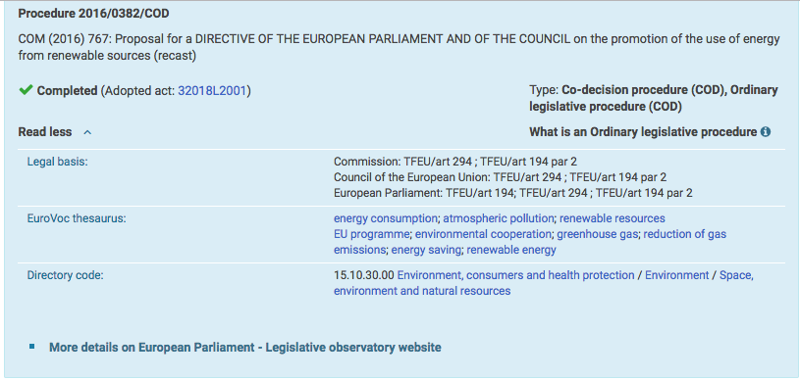
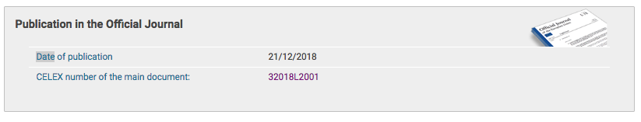
https://eur-lex.europa.eu/legal-content/EN/HIS/?sortOrder=asc&uri=CELEX%3A32018L2001

Slide 11
« COD » is not part of the id (a project can change type during its life)
LegislativeProcess
process_id: 2016/0382
process_name : COM (2016) 767: Proposal for a DIRECTIVE OF THE EUROPEAN PARLIAMENT AND OF THE COUNCIL on the promotion of the use of energy from renewable sources (recast)
process_type : Co-decision procedure (COD)
process_type : Ordinary legislative procedure (COD)
process_status: Completed
had_legal_basis: Commission: TFEU/art 294 ; TFEU/art 194 par 2
had_legal_basis: Council of the European Union: TFEU/art 294
had_legal_basis: European Parliament: TFEU/art 194; TFEU/art 294 ; TFEU/art 194 par 2
is_subject_of : http://www.europarl.europa.eu/oeil/FindByProcnum.do?lang=en&procnum=OLP/2016/0382
This is how the title is dispayed in Eur-Lex even though this is the title of the COM document.
based_on_a_realization_of
created_a_realization_of_legal_resource
process_keyword
DraftLegislationWork
legislative_process_work_version: « as initiated »
legislative_process_work_date: 2018-07-10
legislative_process_work_id : (2016) 767
skos:Concept
skos:prefLabel : energy consumption
LegalResource
http://data.europa.eu/eli/dir/2018/2001/oj
eli:date_document: 2018-12-21
eli:id_local: 32018L2001
is_about
skos:Concept
skos:prefLabel : energy consumption
skos:Concept
Note : in this example we have repeated the legal basis and the keywords on the LegislativeProject; a detailed analysis should determine if this should be the case or not.

Slide 12
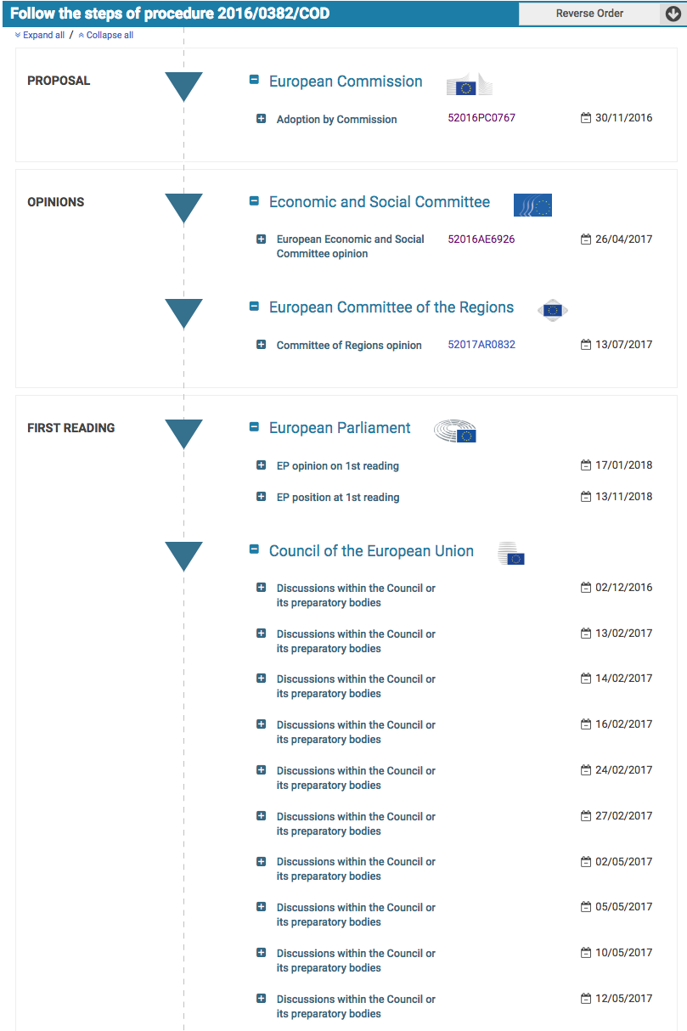
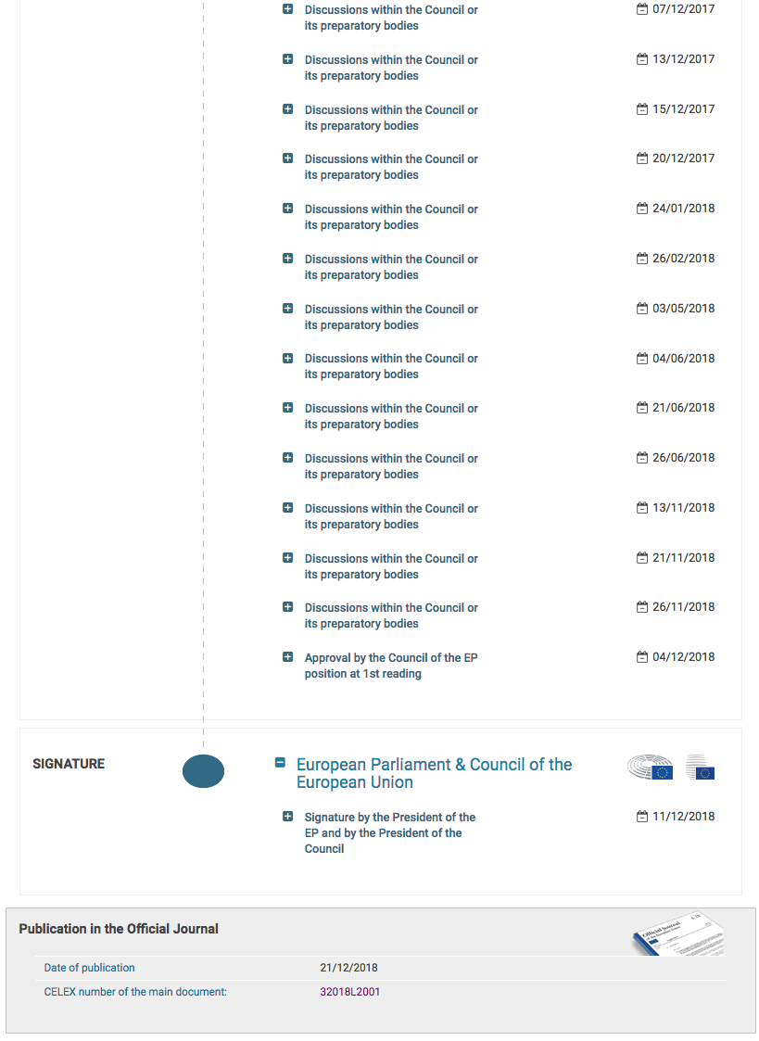
https://eur-lex.europa.eu/legal-content/EN/HIS/?sortOrder=asc&uri=CELEX%3A32018L2001

Slide 13
LegislativeProcess
legislative_process_id: 2016/0382
...
There might be more steps involved in the adoption by the commission, but not visible on Eur-Lex
consists_of
created_a_realization_of_legal_resource
LegislativeActivity
occured_at_stage: Adoption by Commission
had_responsible_organization: Directorate-General for energy, European Commission
activity_date: 2016-11-30
LegislativeActivity
occured_at_stage: European Economic and Social Committee Opinion
had_responsible_organization: Economic and Social Committee
activity_date: 2017-04-26
LegislativeActivity
occured_at_stage: Committee of Regions opinion
had_responsible_organization: European Committee of the Regions
activity_date: 2017-07-13
LegislativeActivity
occured_at_stage: EP opinion on 1st reading
had_responsible_organization: European Parliament
activity_date: 2018-01-17
LegislativeActivity
occured_at_stage: EP position at 1st reading
had_responsible_organization: European Parliament
activity_date: 2018-11-13
LegalActivity
activity_stage: Discussion within the Council or its preparatory bodies
activity_responsible: European Parmliament & Council of the European Union
LegislativeActivity
occured_at_stage: Signature by the President of the EP and by the President of the Council
had_responsible_organization: European Parmliament & Council of the European Union
activity_date: 2018-11-12
LegislativeActivity
occured_at_stage: Publication in the Official Journal
activity_date: 2018-12-21
created_a_realization_of_legal_resource
LegalActivity
activity_stage: Discussion within the Council or its preparatory bodies
activity_responsible: European Parmliament & Council of the European Union
LegalActivity
activity_stage: Discussion within the Council or its preparatory bodiesLegalActivity
activity_stage: Discussion within the Council or its preparatory bodies
activity_responsible: European Parmliament & Council of the European Union
activity_responsible: European Parmliament & Council of the European Union
LegislativeActivity
occured_at_stage: Discussion within the Council or its preparatory bodies
had_responsible_organization: Council of the European Union
activity_date: 2016-02-12
LegalResource
http://data.europa.eu/eli/dir/2018/2001/oj

Slide 14
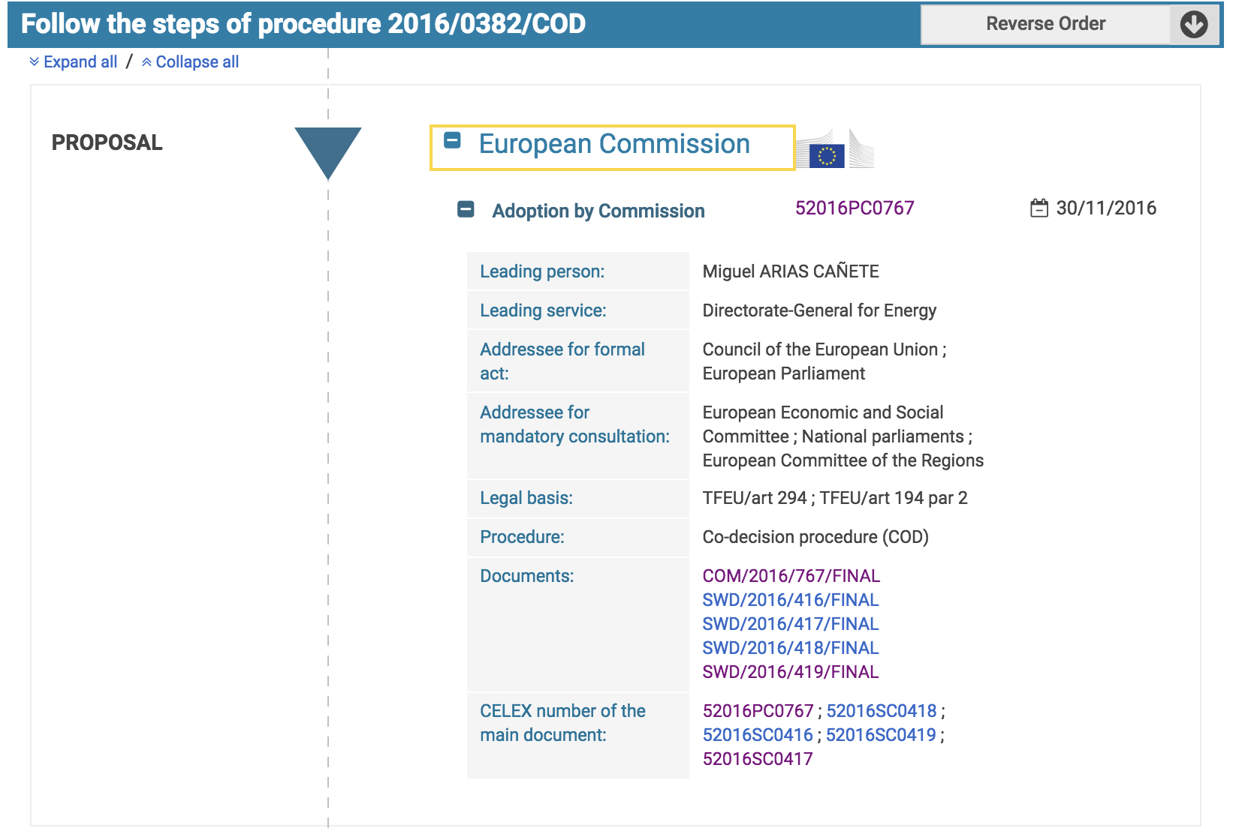
COM Document
Staff Working Documents
https://eur-lex.europa.eu/legal-content/EN/HIS/?sortOrder=asc&uri=CELEX%3A32018L2001

Slide 15
LegislativeProcess
consists_of
LegislativeActivity
activity_stage: Adoption by Commission
had_responsible_organization: European Commission
had_responsible_organization: Directorate-General for Energy
had_responsible_person: Miguel ARIAS CAÑETE
activity_date: 2016-11-30
had_legal_basis: TFEU/art 294
had_legal_basis: TFEU/art 194 par 2
Legal basis is already expressed at the LegislativeProject level.
Should it be repeated ?
created_a_realization_of
involved_work
LegislativeProcessWork
legislative_project_work_id: 52016SC0418
LegislativeProcessWork
legislative_project_work_id: 52016SC0416
LegislativeProcessWork
legislative_project_work_id: 52016SC0419
LegislativeProcessWork
legislative_project_work_id: 52016SC0417
COM document
DraftLegislationWork
legislative_project_work_id: 52016PC0767
Note : in this example « adressee for formal act » and « adressee for mandatory consultation » are not mapped. A detailled analysis should determine if/how they can be mapped to ELI-DL.

